Slide 2
Caspeco ab
Uppsala based IT company
10 years building Business Systems
Mainly focused on the .NET platform
Current largest product is a winforms application
Need to move forward to support more platforms
Mobiles
Tablets
Mac
Etc…

Slide 3
Developing web applications with react.js

Slide 4
What is react.js?
Javascript library
Developed by Facebook
Currently being used by Instagram, Facebook, Netflix, Yahoo, Airbnb, Sony, Atlassian and others
UI/view library only

Slide 5
Key features
Everything is a component
MyApp
MainMenu
List
Button
Reusable components
Button
List
Datepicker

Slide 6
Key features
Simple mental model
No manual UI updates
Everything is rerendered when data changes
Almost like old school server side rendering
Slow? No. Powered by a virtual DOM
React calculates the minimal set of DOM manipulations

Slide 7
What is a component?
Can render itself
render() <- must return a component (or null)
render() <- Can use jsx to make things nice…
Can receive *properties* from parent component
Can ”raise events” – call parent via callback functions passed as props
onClick()

Slide 8
Properties?
A property is the way data enters a component
<button text=”do not push!” />
<button text={someObject.buttonText} />
<button text={this.getButtonText(this.state)} />

Slide 9
JSX – ”html in javascript”
JSX – javascript syntax extension
XML like syntax to describe tree of components
Preprocessed – not natively supported by browsers
Scary? No!
Optional, but very useful
Easier to read
Easier to write

Slide 10
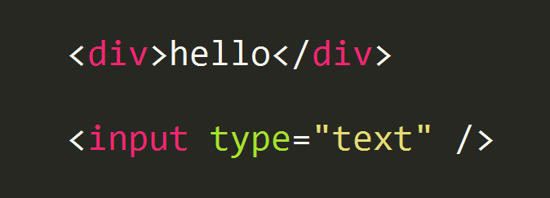
What does jsx look like?

Slide 11
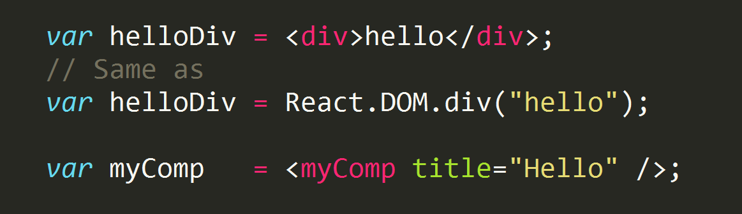
What does jsx look like?

Slide 12
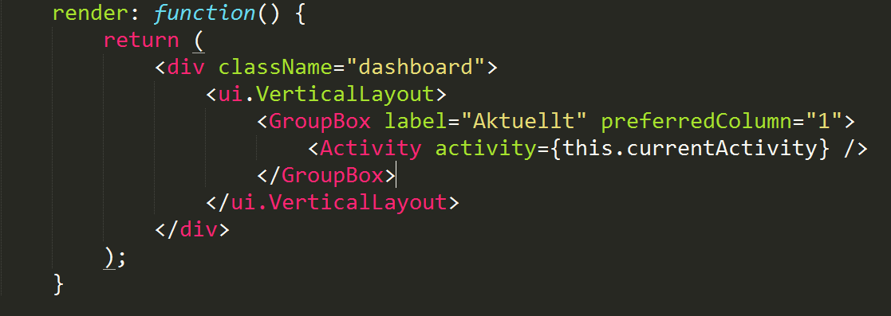
What does jsx look like?

Slide 13
Application structure
<TodoApp />
<NewTodo />
<TodoList />

Slide 14
demo

Slide 15
Useful stuff
Server side rendering
React router
Flux
Not a library – a design pattern
Data flow management
How to write full applications using React
WebPack hot updates
https://github.com/Caspeco/reactjs-demo
Presentation + Demo + Links to useful stuff

Slide 16
Kthxbye
Anders Åberg
@bigcheeseanders
anders@caspeco.se
Henrik Hallin
henrik@caspeco.se
https://github.com/Caspeco/reactjs-demo
Presentation + Demo + Links to useful stuff

Slide 17
Questions?

